Slide 1
Clinic Appointments System
Dongfan Zhang

Slide 2
Bbackgrounds: a system to manage appointments for small clinics
System can eliminate the manual appointment taking. Increase efficiency.
allow patients to take appointments, view appointments and cancel appointments, update his own contact data
allow doctors to manage their schedule, view patients’ profile, view existing appointments, update his own contact data
allow administrator to manage doctors, patients, appointments, etc.

Slide 3
Solution overview – three user interface
When user successfully logged in, based on their user profile, system will populate the correct user interface for them and each will have different functionalities implemented
Patient
Doctor
Admin

Slide 4
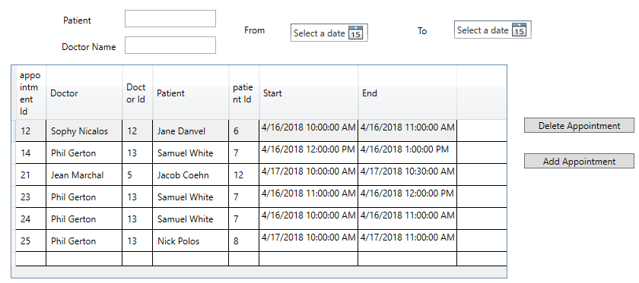
Admin- Manage appointments

Slide 5
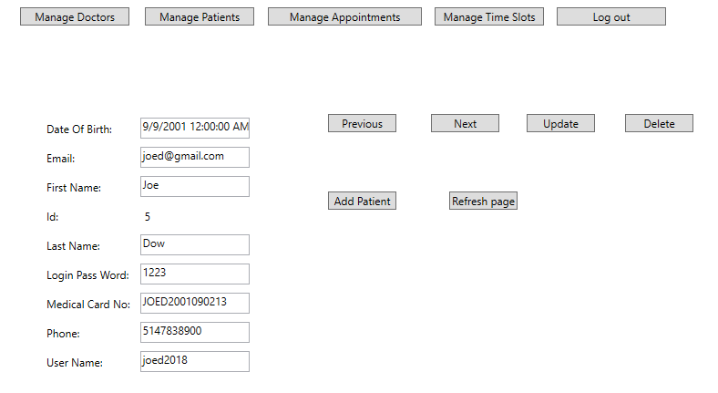
Admin – Manage Patients

Slide 6
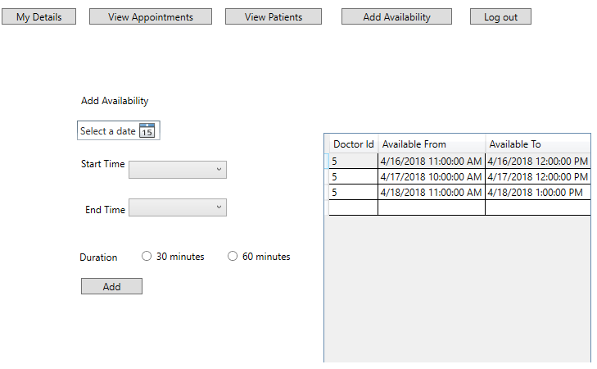
doctor – Add availability

Slide 7
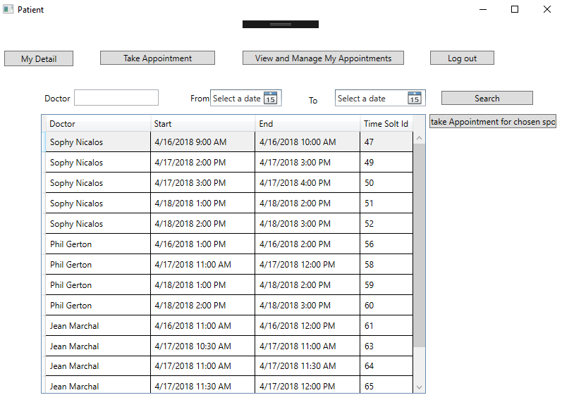
Patient

Slide 8
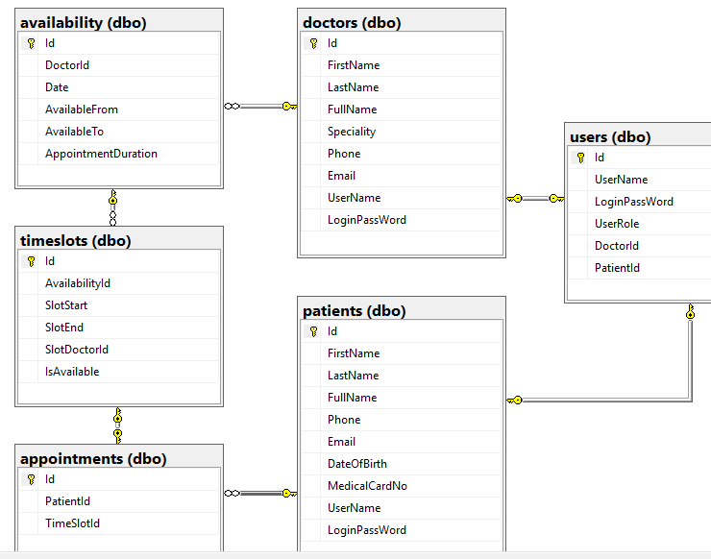
Schema

Slide 9
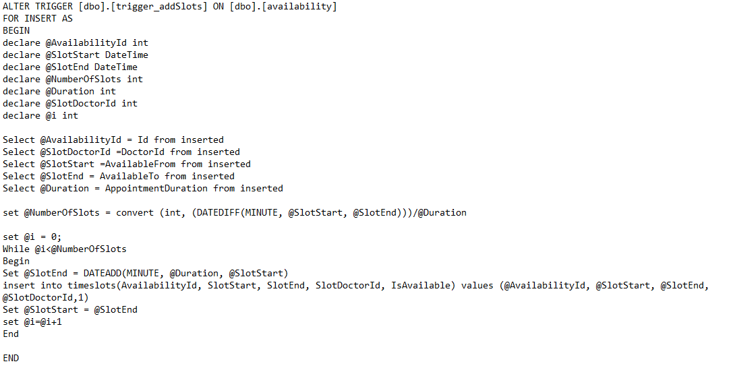
Challenge: time slots

Slide 10
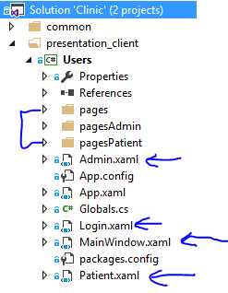
Structure of projects
Common- entity framework with all the classes reflect to tables of database
User – presentation – login is the entry point of the program then direct to different windows as doctor, patient, or admin.
In each of those window, has pages to navigate through different functions.
Has one Globals class to keep the information which user is logged in

Slide 11
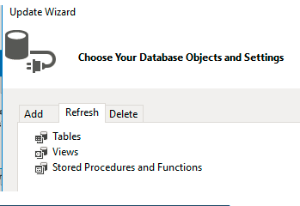
challenge – using entity framework for this project
I adopted database first approach.
While binding tables / views to UI controls is not a problem, but while the project is going, I need to add and modify views in the database, then have to find way to update model in project as well.
I tried to update through refresh, and always have a bunch of errors. Then I figured out whenever update a table, or a view, first delete that table or view. Then add through update wizard Add, that will not give error for mapping.

Slide 12
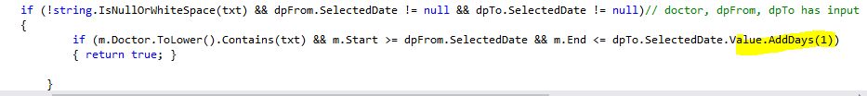
What we learned
Working with dates in C# and WPF
The DateTime is the the data type to be used in C#, and by default it is set to the a date with a time as 12:00 am.
When I tried to set up the search by date From and To, I realize there is something wrong, it does not work properly, that is because the date To was set with a time 12:00 am. So I need to add one day for the search to work.

Slide 13
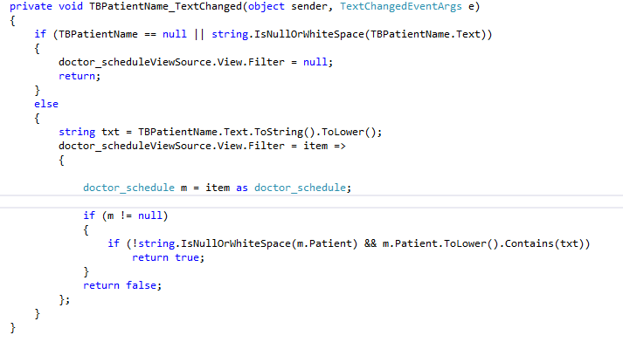
Dynamically filter the data

Slide 14
Future improvement
Add user registration
Add some data entry validation
Add report function to print out the schedule
Add email reminder 48 hours before the appointments to patients

Slide 15
Summary
The functions planned for different users are all implemented and working.
Did not use the scheduler control at this point because the third party tool DevExpress who provides the scheduler requires a implementation of MVVM (Model–View–ViewModel), I am not sure how to use a structure of MVVM.
Overall I am satisfied with the result achieved so far.

